Slide 1
Graduation project

Slide 2
AGENDA
• Project Overview
• Manual Testing
• Automation Testing
• API Testing

Slide 3
Project overview
https://github.com/Shehab-Badran/Graduation-Project-Testing-

Slide 4
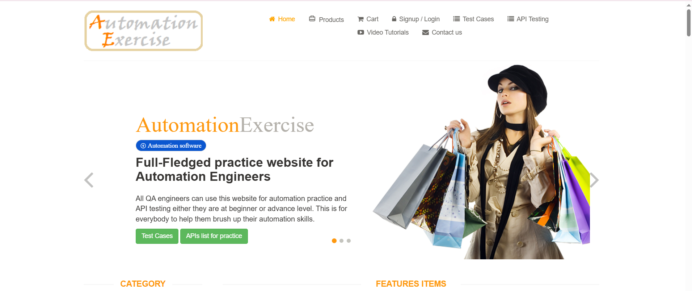
The tested website:
https://automationexercise.com/

Slide 5
What is the site features :
Full-fledged e-commerce platform:
It simulates a real online shopping experience with various functionalities to test.
Browse Products: View a catalog of simulated products.
View Product Details: Access information like name, price, and images for individual items.
Add to Cart: Place selected products into a virtual shopping cart.
View Cart: See the items added to the cart, including quantities and prices.
Update Cart: Modify quantities or remove items from the cart.
Proceed to Checkout (Simulated): Go through the steps of a typical checkout process (filling in details).
User Registration/Login: Create and access user accounts.

Slide 6
We use this website to exercise on :
The Manual Testing Skills. (Excel)
Automation Testing Skills. (…)
API testing. (Postman)

Slide 7
Manual testing

Slide 8
The main manual testing points :
Authentication & Authorization
3. Cart & Checkout
Product Search & Filtering
Search products using the search bar (valid and invalid queries)
Use product categories & brand filters
Sorting products (price low to high, high to low)
Add/remove products from the cart
Increase/decrease product quantity in the cart
Proceed to checkout (with and without login)
Apply discount coupons (if available)
Payment process simulation
Register a new user (valid and invalid inputs)
Login with valid and invalid credentials
Forgot Password functionality
Logout functionality

Slide 9
The main manual testing points :
4. User Profile & Orders
5. Contact Form & Newsletter
Update personal details (name, email, password)
View order history
Cancel an order
Download invoice
Submit a message using the contact form
Subscribe/unsubscribe to the newslette

Slide 10
Automation testing

Slide 11
The main automation testing points :
BrandPage.java
CartPage.java
CategoryPage.java
CheckoutPage.java
ContactUsPage.java
HomePage.java
LoginPage.java
NewsletterPage.java
PageBase.java
ProductPage.java
RegisterPage.java
SearchPage.java

Slide 12
Positive and negative scenarios :
BrandTests_happyScenario.java
BrandTests_negativeScenario.java
CartTest_happyScenario.java
CartTest_negativeScenario.java
CategoryTests_happyScenario.java
CategoryTests_negativeScenario.java
CheckoutTests_happyScenario.java
CheckoutTests_negativeScenario.java
ContactUsTests.java
Login_NegativeScenario.java
LoginTests_happyScenario.java
NewsletterTest_happyScenario.java
NewsletterTest_negativeScenario.java
ProductTests_happyScenario.java
RegisterTests_happyScenario.java
RegisterTests_negativeScenario.java
SearchTests_happyScenario.java
SearchTests_negativeScenario.java
TestBase.java

Slide 13
Test Suite Files Summary
Brand_Suite.xml: Tests related to brand filtering and validation
Cart_Suite.xml: Covers adding/removing products and updating cart
Category_Suite.xml: Tests category-wise product browsing
Checkout_Suite.xml: Handles checkout flow including billing & payment
ContactUs_Suite.xml: Validates contact form submission and alerts
Login_Suite.xml: Tests login scenarios (valid/invalid creds, edge cases)
Newsletter_Suite.xml: Verifies email subscription functionality
Product_Suite.xml: Tests product page functionality and data
Register_Suite.xml: Covers user registration with validations
Search_Suite.xml: Verifies search feature and result accuracy

Slide 14
Api TESTING
https://app.getpostman.com/join-team?invite_code=1847ad4d1bc238dcf560301944c37d5c5837191838712eb16f8c7001824deb69

Slide 15
What is the API :
API is Application Programming Interface.
Some of the used api:
GET /products:
*Returns a list of all available products.
*Useful for verifying product data like name, price, and category
2. GET /products/search?q={product_name}:
*Searches for products by name
*Supports testing search accuracy and response times
3. POST /login:
*Accepts email and password to authenticate users
*Used to test login functionality and error handling

Slide 16
4. POST /signup:
*Allows new user registration with user details
*Useful for validating response codes and duplicate checks
5. DELETE /deleteAccount:
*Deletes a registered user account (after authentication)
6. POST /verifyLogin:
*Confirms that a login was successful
*Can be used in test scenarios after login
7. GET /categories:
*Retrieves product categories and sub-categories
*Useful for validating navigation and filtering
8. POST /cart:
*Adds a product to the cart with product ID and quantity
*Checks shopping cart API integration

Slide 17
Challenges faces :
Dynamic elements and locators
2. API rate limiting and authorization
3. The final examsss which is started in this timing .

Slide 18

Future Recommendations
Expand automation coverage
Suggest site enhancements to the developers

Slide 19
Team members:
Shehab Hatem Soliman
Abdelrahman Mahmoud Shoukry
Abdelrhman Alaa Abdelmhsen
Maryam Mohamed Farouk
Shahd Wael Hassan

Slide 20
THANK YOU

